Slide 1

Practical Nursing Program Information
Hennepin Technical College
09/2025

Slide 2

Overview of Information
Pre-Requisites to the Nursing Program
CPR & Nursing Assistant Certifications
Immunizations Required
Nursing Program Courses Outline
TEAS Assessment for Enrollment
Apply with Online Application

Slide 3


Program Overview
Enrollment in Fall OR Spring term
Brooklyn Park campus- Fall term
Eden Prairie campus- Spring term
2 Semester of Nursing Courses to Graduation

Slide 4

Steps to Application
Step 1- Pre-Requisite Courses
Step 2- Qualifying scores in Reading, Writing, and Math
Step 3- Current CPR Certification
Step 4- Nursing Assistant Certification or Course Completion
Step 5- Documentation of Immunizations
Step 6- TEAS Entrance Exam

Slide 5
Pre-Nursing Application Requirements
Qualifying scores in Reading, Writing, and Math
College-Level Writing (one course)
ENGL1100 Writing and Research
ENGL1250 Short Form Composition and Reporting
NURS or BIOL Courses (one course)
NURS1135 Healthcare Anatomy & Physiology
BIOL1400 Human Biology
Medical Terminology (one course)
NURS1121 Medical Terminology
EMSV1146 Medical Terminology for EMS/ER Personnel

Slide 6
Pre-Nursing Courses
Transfer specialist can assist if courses taken at another college
transfer@hennepintech.edu if you have questions
Must earn a “C” in all Nursing pre-requisite courses
Courses can only be repeated once in 3 year period for higher grade
Courses can be In Progress when apply to Nursing Program
Must achieve a passing grade before acceptance

Slide 7
Math Requirement
Quantitative Reasoning, Algebra, and Stats (QAS) Accuplacer
2 attempts allowed to achieve 261 or higher
If score is less than 261
Math course required
MATH0960 Math Literacy OR
MATH0940 Beginning Algebra
Accuplacer information is found on DARS
Student Success Advisor, angel.hoglund@hennepintech.edu can also verify math placement

Slide 8
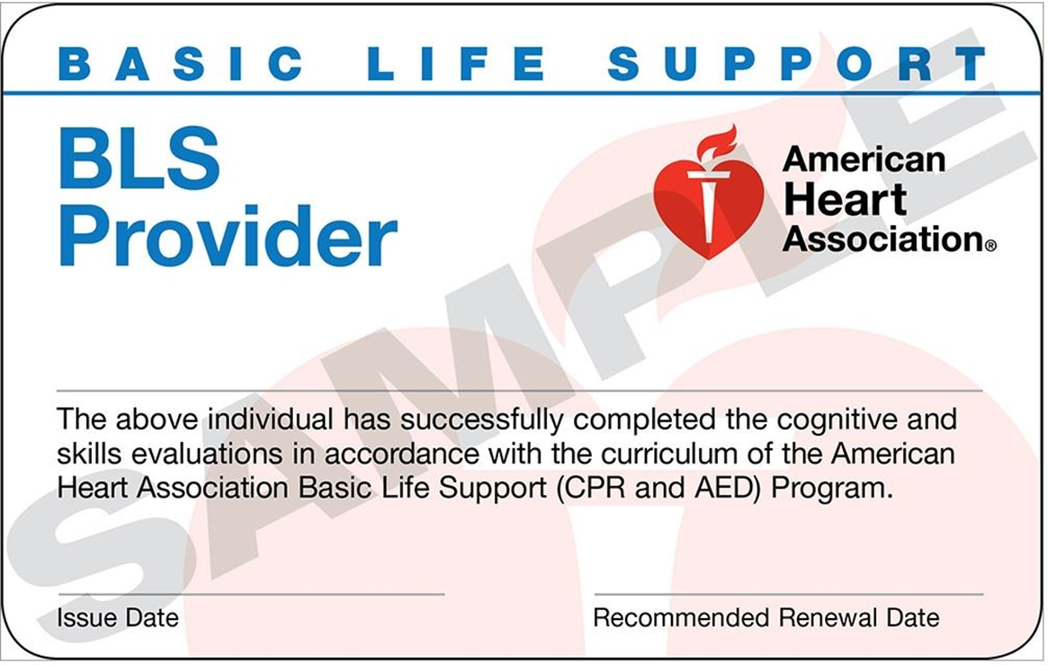
Current CPR Certification
CPR certification must remain current through program
Courses accepted:
American Heart Association or Red Cross
BLS/CPR for Healthcare Provider
BLS Provider
CPR for Healthcare Provider
EMSV1020 CPR/First Aid
NOT accepted:
Online courses
CPR for non-professionals (Heartsavers)

Slide 9


Completed Nursing Assistant
Course completed within the State of Minnesota
NAHA1010 Nursing Assistant
On the Minnesota Department of Health registry

Slide 10
Immunizations
Form is available on HTC Practical Nursing program webpage
Immunizations Needed:
MMR, Varicella, Tdap, Hepatitis B
Seasonal Influenza
August enrollments- due by October
January enrollments- current season vaccine, due by 1st day of classes
COVID vaccination (recommended)
Proof of freedom from active Tuberculosis (within last 3 months)
Signature of form by a healthcare provided is needed
Primary provider or local Public Health can sign form

Slide 11

Next Step…….TEAS Test
Complete the TEAS entrance exam
Testing must be completed in person
Test of Essential Academic Skills (TEAS)
Reading; Math; Science; English & Language Usage
TEAS testing available on Campus
Schedule with the Testing Center
https://hennepintech.edu/future-students/testing/index.html

Slide 12

Nursing Program Courses
On campus Classroom lectures
Nursing Skills in Lab
Case scenarios in Simulation
Clinicals in Community Settings
Long Term Care
Transitional Care Units
Acute Care Settings
School Settings

Slide 13
Nursing Course Information
Apply to either Eden Prairie or Brooklyn Park campus
On campus courses completed at enrolled campus
Lectures, Labs, and Simulations
Clinical experiences are in the community
A grade of 80% or higher is earned to pass the course
Nursing faculty and campus resources are available to support success
Nursing courses can be repeated one-time during the program

Slide 14
Nursing Courses Enrollment to Graduation
1st Semester
NURS1376- Introduction to Nursing
NURS1381- Introduction to Medical Surgical Nursing
NURS1425- Pharmacology I
NURS1430- Medical Calculations
NURS1435- Nursing Skills Lab I
NURS1440- Nursing Clinical I
NURS1445- Nursing Clinical II
2nd Semester
NURS2376- Medical Surgical Nursing II
NURS2325- Pharmacology II
NURS2335- Nursing Skills Lab II
NURS2350- Nursing Clinical III
NURS2381- Nursing Care Across the Lifespan

Slide 15
AAS Degree or Diploma?
Students with Diploma or AAS degree are both eligible to complete NCLEX testing for licensure
https://mn.gov/boards/nursing/licensure/apply-for-a-license/rn-lic-exam-us-prog.jsp
Diploma requires 42 credits
Associate in Applied Science Degree requires 60 credits
AAS degree does not provide advantage for employment or wages in MN
AAS degree does provide students continuing into an RN/BSN program some general education requirements
Consult individual program for specific requirements

Slide 16

Ready to Apply to the Nursing Program?
48 Students accepted to each Cohort
Courses in progress
Yes! You can still apply
Transfer students
Yes! You can still apply
Work with an Advisor
Submit all Documents with Online Application

Slide 17

Online Application
Link to apply to the nursing program found on Program webpage
Needed to submit an online application:
StarID and password
TEAS Admission Assessment Report
Current BLS/CPR Certification
CNA Certification Verification
Completed & Signed Immunization form

Slide 18
Acceptance to Nursing Program
Response to application will be sent to student HTC email only
Email is the official communication
Following acceptance to the nursing program:
Register for classes
An outline of the first week of classes is provided
The bookstore has a nursing bundle for purchase
Application for a required background study will be completed the first week
"Clear background study" means the student has not been convicted of a gross misdemeanor or felony. These convictions also include those NOT against a person, so this is different than the background a student might have done for a nursing assistant position or previous employer

Slide 19

Questions?
Director of Nursing: Cheryl Lassen MSN, BSN, PHN
cheryl.lassen@hennepintech.edu
Student Success Advisor: Angel Hoglund angel.hoglund@hennepintech.edu

